Slide 1

CSCI311 COMPUTER ARCHITECTURE
Names And ID’S
Wesal Soliman 231001686
Rana Mohsen 231001397
Rama Mousa 231001373
Raneem Khaled 231001424
Lina Ashraf Sediq 231001820
Single-Cycle RISC-V Processor Design

Slide 2
CPU Design
  A single-core RISC-V 64-bit processor
  Supports R-type, I-type, S-type, and B-type instructions
  Modular design for easy integration and testing

Slide 3

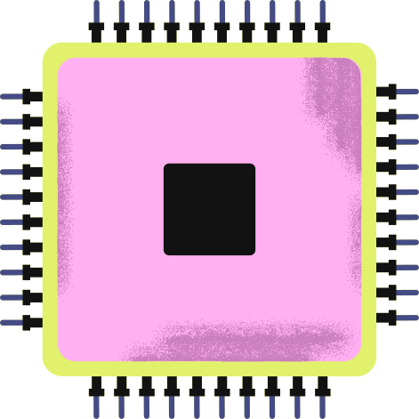
Modules Used
Control Unit (CUpALUControl)
  Generates control signals for CPU operation: RegWrite, MemRead, MemWrite, ALUSrc, MemToReg, Branch, Jump, ALUControl
  Decodes instructions using opcode, funct3, funct7
  Merges main control and ALU control in one module

Slide 4
PC & Branch Logic
  Program Counter (PC) updates every clock cycle
  Calculates branch target addresses
  Selects next PC using branching/jump logic

Slide 5
ALU
  Performs arithmetic and logic operations: add, sub, and, or, xor, sll, srl
  Inputs: two operands, ALUControl
  Outputs: result, zero flag
  Tested with a dedicated ALU testbench

Slide 6
Register File
  32 general-purpose registers (x0 always 0)
  Two read ports, one write port
  Synchronous write, asynchronous read
  Reads operands for ALU and writes back results

Slide 7
Immediate Generator (ImmGen)
  Extracts and sign-extends immediate values from instructions
  Supports R, I, S, B, U, J types

Slide 8
Instruction Memory
  Stores preloaded instructions
  Word-aligned addressing
  Supplies instructions to the CPU at current PC
Data Memory
  Supports ld (load) and sd (store) instructions
  Reads and writes data during execution

Slide 9
CPU Top-Level (cpu_top)
  Integrates all modules: ALU, Control, Register File, ImmGen, Memory, Branch Logic
  Handles instruction sequencing and data flow
  Tested with full CPU simulation

Slide 10
CPU Implementation
Immediate Generation: Handled by ImmGen
Top-Level Module: cpu_top.v
Interconnections: ALU → Register File → Memory → Branch Logic
Simulation: Tested with testbench cpu_top_tb.v

Slide 11
Pipeline
Stages Implemented in Our CPU:
  IF – Instruction Fetch: Read instruction from memory using PC
  ID – Instruction Decode: Decode instruction, read registers, generate immediate
  EX – Execute: ALU performs arithmetic/logic operations
  MEM – Memory Access: Read/write from/to data memory if needed
  WB – Write Back: Write result back to register file
A technique to improve CPU performance by executing multiple instructions simultaneously in different stages.

Slide 12
Challenges & Solutions
Top-Level Integration
Challenge: Connecting all modules without errors
Solution: Integrated and tested step by step, starting from ALU → Register File → Memory → Control → CPU top
Immediate Generation
Challenge: Handling different instruction formats (I, S, B types)
Solution: Used a dedicated ImmGen module to extract and sign-extend immediates correctly

Slide 13

THANK YOU

